Slide 1

OSGi Declarative Services versus Spring Dynamic Modules
Heiko Seeberger WeigleWilczek Kai Tödter Siemens Corporate Technology

Slide 2
Agenda
Demo: A Swing App Framework based dynamic OSGi application
OSGi Services
Providing and consuming Services
Service Tracker
Overview Declarative Services & Spring Dynamic Modules
Declarative Services in Detail
Spring Dynamic Modules in Detail
Comparison (DS vs. DM)
Conclusion & Best Practices
Discussion

Slide 3
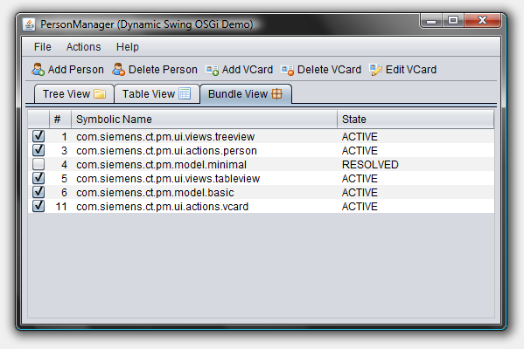
Demo

Slide 4
How to get the Demo?
The PM Demo project home page is: http://max-server.myftp.org/trac/pm
There you find
Wiki with some documentation
Anonymous Subversion access
Trac issue tracking
Licenses
All PM project sources are licensed under EPL
Swing Application Framework (JSR 296) implementation is licensed under LGPL
Swing Worker is licensed under LGPL
The nice icons from FamFamFam are licensed under the Creative Commons Attribution 2.5 License

Slide 5
Agenda
Demo: A Swing App Framework based dynamic OSGi application
OSGi Services
Providing and consuming Services
Service Tracker
Overview Declarative Services & Spring Dynamic Modules
Declarative Services in Detail
Spring Dynamic Modules in Detail
Comparison (DS vs. DM)
Conclusion & Best Practices
Discussion

Slide 6

OSGi is Service-Oriented!

Slide 7
Providing a Service (1)
Service
Registry
<< register >>
POJO
<< implement >>
Service
Interface
Service
Properties

Slide 8
Providing a Service (2)
An OSGi service is a POJO ...
... registered under one ore more service interface names ...
... and optional service properties
BundleContext
+ registerService(String, Object, Dictionary): ServiceRegistration
+ registerService(String[], Object, Dictionary): ServiceRegistration

Slide 9
Consuming a Service (1)
Service
Registry
<< look-up >>
Service
Reference
POJO
<< implement >>
Service
Interface
Service
Properties

Slide 10
Consuming a Service (2)
First a service reference is looked-up by the Service Interface name
Second the service object is obtained using the Service Reference
The Service Registry keeps track of obtained service objects
When no longer needed, a service object must be returned
BundleContext
+ getServiceReference(String): ServiceReference
+ getService(ServiceReference): Object
+ ungetService(ServiceReference): boolean

Slide 11

How to deal with Service Dynamics?

Slide 12
Services might come and go
Service Look-ups might fail, because ...
... bundle(s) providing service not started yet
... service(s) not registered yet
... bundle(s) providing service stopped
...
Best practice:
Better listen to service events than looking up services.

Slide 13
Service Listeners ...
... will receive all service events
REGISTERED, MODIFIED, UNREGISTERING
... or a filtered subset
BundleContext
+ addServiceListener(ServiceListener): void
+ addServiceListener(ServiceListener, String): void

Slide 14
Dynamic Services are difficult to handle (1)
Possible solution:
(1) Frist look-up all existing services
(2) Then register a Service Listener to stay tuned
Problem: Possibility to miss out on some services registered or unregistered between (1) and (2)
Typical task:
Track all services of a certain type, i.e. all that are
already there as well as all that will come and go.

Slide 15
Dynamic Services are difficult to handle (2)
Alternative solution: Reverse the steps
(1) First register a Service Listener to stay tuned
(2) Then look-up all existing services
Problem: Watch out for duplication!
Best practice:
Service Listeners are low-level and their usage is error-prone.
Better use Service Trackers.

Slide 16
The Service Tracker
Utility class specified in OSGi Service Compendium
Package: “org.osgi.util.tracker”
Based on Service Listeners and “a lot of knowledge”
Services to be tracked may be specified by ...
... a Service Interface name
... a filter
Must be opened to start and closed to stop tracking
Handles service events via the methods
addingService()
modifiedService()
removedService()

Slide 17
Services in very dynamic Scenarios
Programmatic use of dynamic services works, but has some drawbacks:
Eager creation of services leads to
Large memory footprint
Long startup time
Increasing complexity with decreasing robustness
But is there anything out there that helps here?
Yes, services and dependencies can be specified declaratively!
Declarative Services
Spring Dynamic Modules
Others (e.g. iPOJO)

Slide 18
Agenda
Demo: A Swing App Framework based dynamic OSGi application
OSGi Services
Providing and consuming Services
Service Tracker
Overview Declarative Services & Spring Dynamic Modules
Declarative Services in Detail
Spring Dynamic Modules in Detail
Comparison (DS vs. DM)
Conclusion & Best Practices
Discussion

Slide 19

Overview DS & DM
The next 4 slides show just a very brief overview and examples
Details follow in the rest of this presentation

Slide 20
Declarative Services (DS)
DS is part of the OSGi R4 spec (Service Compendium)
DS let you declare components in XML
The declarations live in OSGI-INF/<component>.xml
Components can provide services
Components can depend on other services
Dependency Injection for references to other services:
References may be bound to bind()-/unbind()-methods in components
A cardinality and a creation policy can be defined
Components need the bundle manifest header Service-Component e.g. Service-Component: OSGI-INF/personManager.xml

Slide 21
PM Example DS Component
<component name="pm.ui.actions.person.ActionContribution">
<implementation
class="pm.ui.actions.person.ActionContribution"/>
<service>
<provide interface= "pm.application.service.IActionContribution"/>
</service>
<reference name="PersonManager"
interface="pm.model.IPersonManager"
bind="setPersonManager"
unbind="removePersonManager"
cardinality="0..1"
policy="dynamic"/>
</component>

Slide 22
Spring Dynamic Modules (DM)
Integration of Spring DI and OSGi
XML files are placed in META-INF/spring directory
One XML file to define a Spring bean
One XML file to map this bean to an OSGi service
Uses Spring dependency injection for references to other services and POJOs
Similar but more flexible/powerful approach compared with DS
But needs around 12 additional Spring and logging bundles to run

Slide 23
PM Example Spring DM Component
XML for Spring Bean:
<beans (schema attributes omitted)>
<bean name="savePerson"
class="pm.ui.actions.save.ActionContribution"/>
</beans>
XML for OSGi service mapping:
<beans (schema attributes omitted)>
<osgi:service id="savePersonOSGi" ref="savePerson" interface="pm.application.service.IActionContribution"/>
</beans>

Slide 24
Agenda
Demo: A Swing App Framework based dynamic OSGi application
OSGi Services
Providing and consuming Services
Service Tracker
Overview Declarative Services & Spring Dynamic Modules
Declarative Services in Detail
Spring Dynamic Modules in Detail
Comparison (DS vs. DM)
Conclusion & Best Practices
Discussion

Slide 25
Service Component Runtime
Providing a service means
Providing an implementation of a service interface
Register the implementation with the service registry
In programmatic approaches, this is usually done by the same bundle
In DS, the Service Component Runtime (SCR) takes care of
Registering/Unregistering the service implementation
Managing the lifecycle
DS introduces the notion of a Component that
Can provide services
Can depend on other services

Slide 26
Needed OSGi Bundles
To run DS with Equinox, the following bundles are needed:
org.eclipse.osgi
org.eclipse.osgi.services
org.eclipse.equinox.ds
org.eclipse.equinox.util

Slide 27
DS Components
Provides Services
optional
Component
Description
(XML)
Component
Instance (POJO)
optional
Depends on Service References

Slide 28
Component Activation
Lazy Activation (Delayed Component)
All dependencies must be resolved
On first request of the service interface the component is activated
This is the default behavior for components providing services
Eager Activation (Immediate Component):
As all dependencies can be resolved the component is created
This is expressed in XML by the component attribute immediate="true"
This should be used only if there is a good reason for!
All components not providing services must be immediate components!

Slide 29
Component Activation (1)
Load Component Instance class
Create Component Instance and Component Context
Bind target services
Call activate() if present

Slide 30
Component Activation (2)
Component Instance class needs a default constructor
activate() and deactivate() may be supplied
Methods are found by reflection
May also be defined in super classes
protected void activate(ComponentContext context)
protected void deactivate(ComponentContext context)

Slide 31
Defining a DS Component
The <component>.xml file
Has to be placed in a directory OSGI-INF
Contains the XML code <component name="ct...person.ActionContribution"> <implementation class="ct...person.ActionContribution"/> </component>
Optional component attributes
immediate: if set true, the component is activated eagerly
Optional tags (see next slides)
service
reference
Components need the bundle manifest header Service-Component e.g. Service-Component: OSGI-INF/<component>.xml

Slide 32
Services and Properties
Specify the interface the component implements as a service, e.g.
<service>
<provide interface=
"pm.application.service.IActionContribution"/>
</service>
Also properties can be defined declaratively, e.g.
<property name="action.name"
type="String" value="SavePersonAction"/>
All defined services will have the component’s properties
TODO: If a component specifies more than one service, will get all the services the same properties? Eine Comp. kann max einen Service spezifizieren (-> XML Schema).

Slide 33
Defining References
DS uses dependency injection for references to other services
The SCR resolves all the references automatically
Only, if all references with respect to the cardinality (see next slide) can be resolved, the component will be activated
<reference name="PersonManager"
interface="pm.model.IPersonManager“
...
/>

Slide 34
Reference Cardinality
Cardinality | Meaning
0..1 | Unary and optional
1..1 | Unary and mandatory
0..n | Multiple and optional
1..n | Multiple and mandatory
Example
<reference name="PersonManager"
...
cardinality="0..1"
/>

Slide 35
Accessing Services – Event Strategy
On (un)binding a referenced service a (un)bind method is called
Methods are found by reflection
Method names are specified in XML
<reference name="PersonManager"
...
bind="setPersonManager"
unbind="removePersonManager"
…
/>
Parameters for bind/unbind method may be the service type or a ServiceReference, e.g.
public synchronized void
setPersonManager(IPersonManager personManager)

Slide 36
Look-up Strategy
Willst Du das weglassen?

Slide 37
Reference Policy
How does unbinding of target services influence the life cycle?
Static policy:
Service Component is deactivated and ...
... activated again if other service(s) available
Dynamic policy:
Life cycle is not affected, as long as references are satisfied
<reference name="PersonManager"
…
policy="dynamic"/>

Slide 38
DS Conclusion
Very easy to define components, services and references declaratively
SCR takes care of life cycle management and dependency resolution
But
Dependency injection only works for other services, not for POJOs or DS components
Properties cannot be declared mandatory

Slide 39
Agenda
Demo: A Swing App Framework based dynamic OSGi application
OSGi Services
Providing and consuming Services
Service Tracker
Overview Declarative Services & Spring Dynamic Modules
Declarative Services in Detail
Spring Dynamic Modules in Detail
Comparison (DS vs. DM)
Conclusion & Best Practices
Discussion

Slide 40
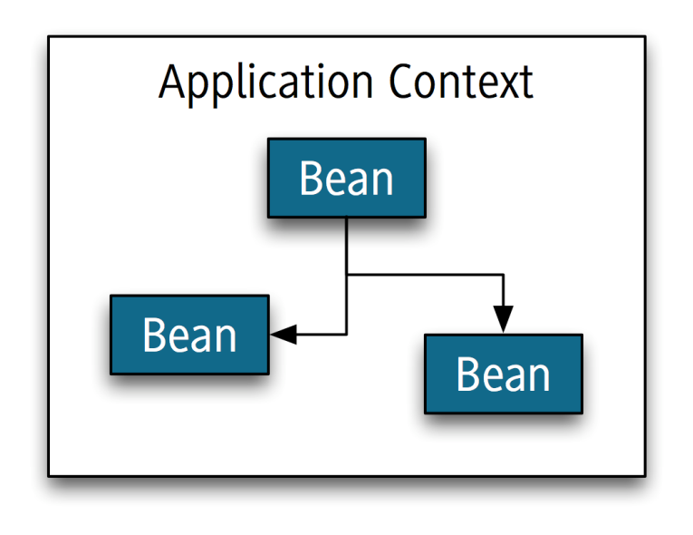
Spring Dependency Injection
Application Context: Lightweight container
Beans: Non-invasive programming model
Dependency Injection

Slide 41
What is Spring DM?
Spring Dynamic Modules focuses on integrating Spring Framework powerful, non-invasive programming model and concepts with the dynamics and modularity of OSGi platform.
It allows transparent exporting and importing of OSGi services, life cycle management and control.
(Spring DM Ref. Guide, 1.0)

Slide 42
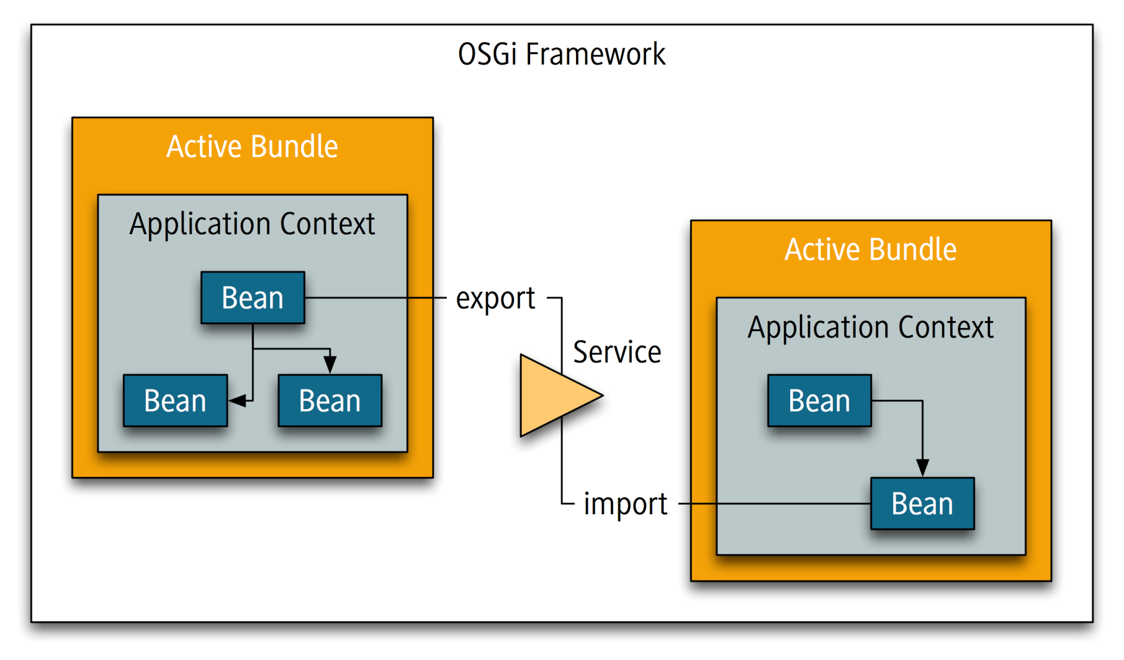
Spring DM at a Glance

Slide 43
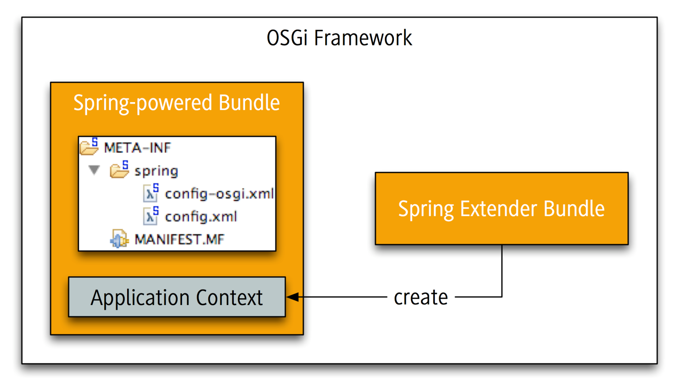
Applying the Extender Model

Slide 44
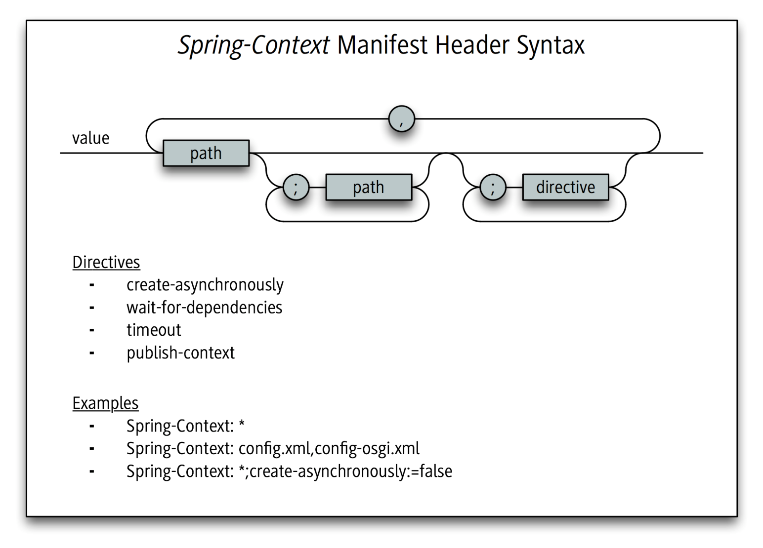
The Spring-Context Manifest Header

Slide 45
Application Context Creation
Directive | Effect
create-asynchronously | Create asynchronously as to OSGi thread? Default is true
wait-for-dependencies | Wait for mandatory dependencies? Default is true
timeout | Time in seconds to wait for mandatory dependencies before failing. Default is 300
publish-context | Publish the Application Context as OSGi service? Default is true

Slide 46
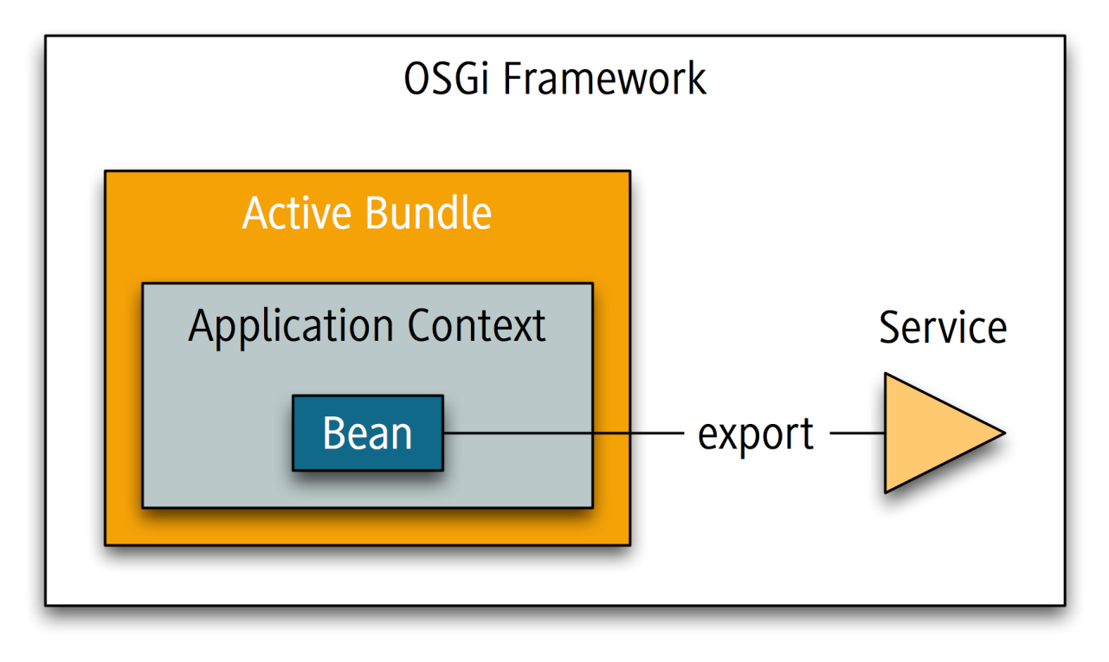
Exporting Beans as OSGi Services (1)
<service ref="..." interface="...">

Slide 47
Exporting Beans as OSGi Services (2)
service Attributes | Meaning
ref | Bean to be exported as OSGi service
interface | FQCN of service interface. Alternatives: auto-export or interfaces sub-element
auto-export | Automatically manage service interfaces. disabled, interfaces, class-hierarchy, all-classes
ranking | Service property service.ranking

Slide 48
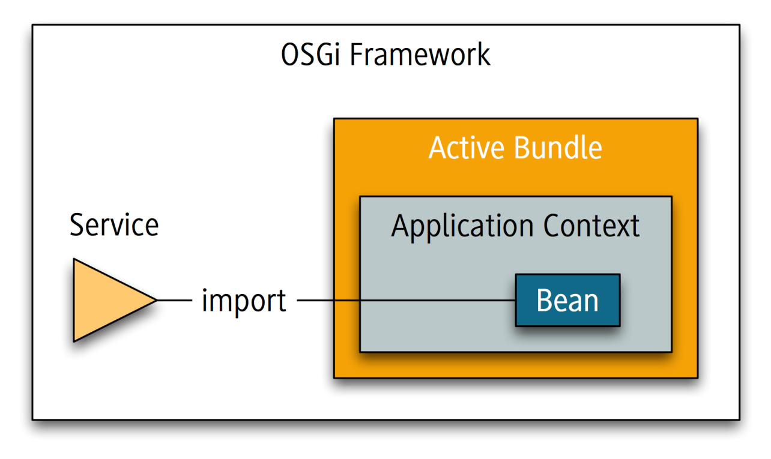
Importing Beans as OSGi Services (1)
<reference id="..." interface="..." cardinality="...">
<set|list id="..." interface="..." cardinality="...">

Slide 49
Importing Beans as OSGi Services (2)
Attributes | Meaning
id | Name of bean for referenced OSGi service
interface | FQCN of service interface. Alternative: interfaces sub-element
filter | OSGi filter expression to constrain service look-up
cardinality | reference: 0..1, 1..1 set|list: 0..N, 1..N

Slide 50
And what about Service Dynamics?
ServiceUnavailableException for invocations on stale references
Unary references (reference) are dynamic-aware
Re-binding with matching service when bound service goes away
Multiple references (set|list) are dynamic-aware
Collections and Iterators always up-to-date with service registry
Services with unsatisfied references are unregistered …
… and re-registered when satisfied again

Slide 51
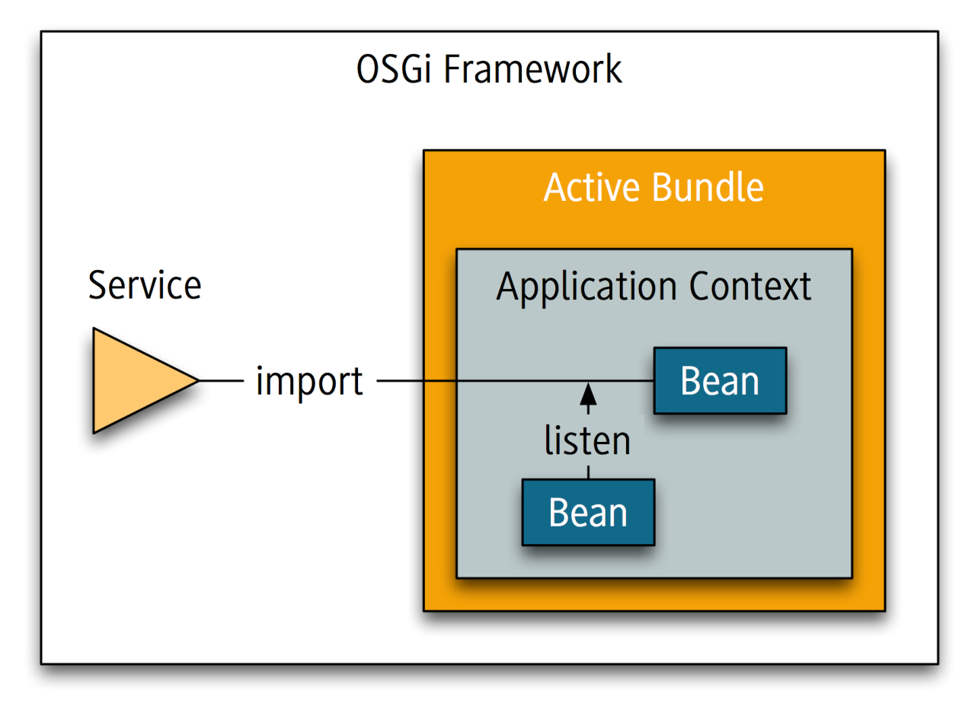
Listening to Service Events
<reference id="..." interface="...">
<listener bind-method="..." unbind-method="...">
<beans:bean class="..."/>
...

Slide 52
Needed OSGi Bundles
To run Spring DM the following additional bundles are needed:
spring-osgi-core-1.1.2.jar
spring-osgi-extender-1.1.2.jar
spring-osgi-io-1.1.2.jar
com.springsource.org.aopalliance-1.0.0.jar
spring-aop-2.5.5.jar
spring-beans-2.5.5.jar
spring-context-2.5.5.jar
spring-core-2.5.5.jar
com.springsource.slf4j.api-1.5.0.jar
com.springsource.slf4j.log4j-1.5.0.jar
com.springsource.slf4j.org.apache.commons.logging-1.5.0.jar
log4j.osgi-1.2.15-SNAPSHOT.jar

Slide 53
Spring DM Conclusion
Very easy to define Spring beans, OSGi services and references declaratively
Spring DM takes care of life cycle management and dependency resolution
Very powerful Dependency Injection
But
Properties also cannot be declared mandatory

Slide 54
Agenda
Demo: A Swing App Framework based dynamic OSGi application
OSGi Services
Providing and consuming Services
Service Tracker
Overview Declarative Services & Spring Dynamic Modules
Declarative Services in Detail
Spring Dynamic Modules in Detail
Comparison (DS vs. DM)
Conclusion & Best Practices
Discussion

Slide 55
Benefits of Both DS & DM
Service Component Model
Simplicity
Delayed Activation
Size Constraints
Backwards Compatibility

Slide 56
DS versus DM
Topic | OSGi DS | Spring DM
Ease of use | ++ | +
Reducing complexity | + | ++
Lazy service activation/creation | ++ | ++ (??)
Compatible with procedural OSGi service model | ++ | ++
Dependency Injection of Services | + | +
Dependency Injection of POJOs | -- | ++
Current tooling support | - | +

Slide 57
Conclusion & Recommendation
We recommend to use either DS or DM rather than manually programming all the service infrastructure and life cycles
If the capabilities of DM are ok with you, use DM
If you need DI or want to use Spring anyway, use Spring DM

Slide 58
Further Information
OSGi Alliance Specifications: Service Compendium, 112 Declarative Services Specification
Component Description schema detailed
Enabling Service Components
Factory Components
Spring Dynamic Modules
Other Service Component models
Apache Felix iPOJO

Slide 59

Discussion

